Slide 1
Using Improv in Your Class
(Without going to 2nd City)
Timothy D. West
Grant Thornton Professor of Accounting
Northern Illinois University

Slide 2
Pathways Commission
(Recommendation 4 – Curricula of the Future)

Slide 3
Critical Thinking
Critical thinking is the process of purposeful, self-regulatory judgment. This process gives reasoned consideration to evidence, context, conceptualizations, methods and criteria. (APA Delphi Report)

Slide 4
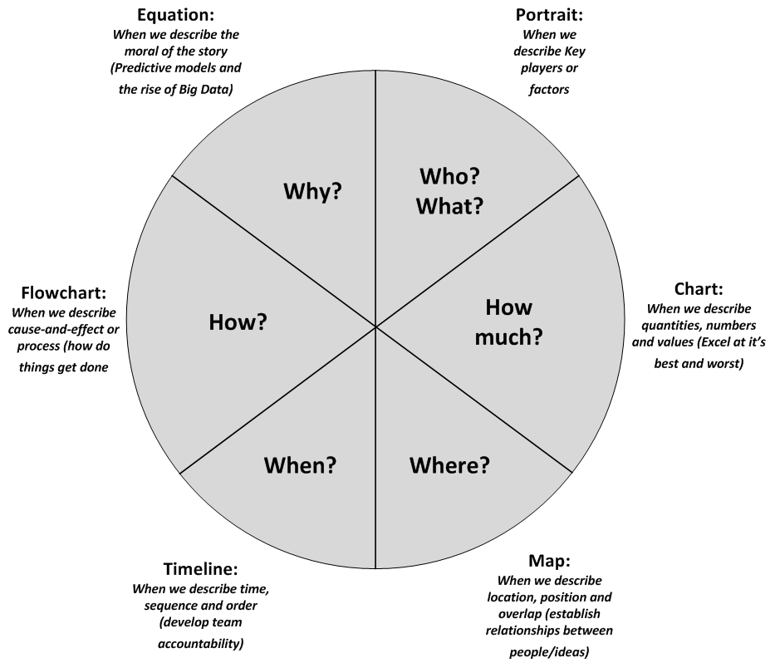
What other Visuals Do Students Need

Slide 5
Tools at Your Disposal

Slide 6


Slide 7
The Goal of Education is …
… to enable students to understand the world around them and the talents within them so they can become fulfilled individuals and active, compassionate citizens.
Creative Schools (2015, xxiv)
Sir Kenneth Robinson with Lou Aronica
Notes:
Four basic purposes of education:
Personal
Cultural
Social
Economic

Slide 8
Battle Rhythm of Education
(My Comfort Zone)

Slide 9
Original TAM Model
(Using your Pedagogical Tools)
Davis, Bagozzi & Warshaw 1989

Slide 10
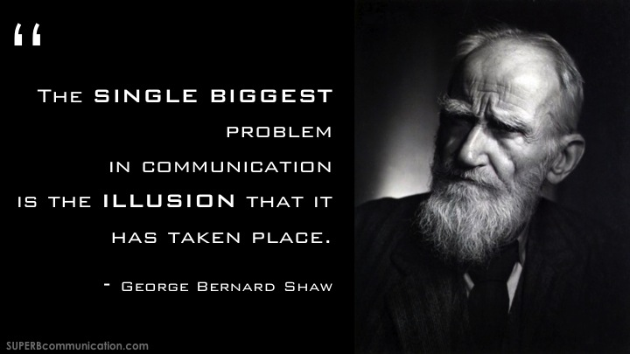

Slide 11
Accounting Students
(What are this?)

Slide 12
ENGAGEMENT

Slide 13

Nobody knows what it’s like to be the sad man …
Behind Blue Eyes ~ The Who
2009

Slide 14
The Second City & NIU
2010
700+
23

Slide 15
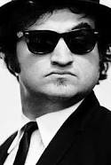
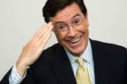
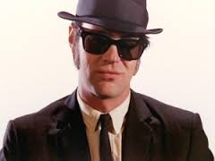
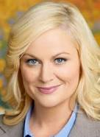
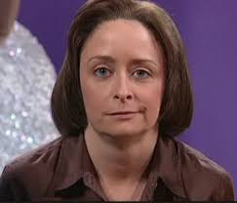


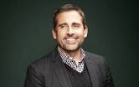
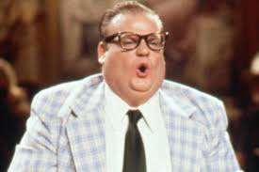

Slide 16

Students Expected:
Subject-Driven Course Design
Are we still great and powerful?

Slide 17

Ensemble-Driven Course Design

Slide 18
Deloitte Alumni Newsletter 2014

Slide 19

1. Co-Create & 2. Ensemble
6. Listen
3. Yes-And
5. Failure
4. Authentic

Slide 20
The Second City
Core Beliefs:
Trust your instincts
Reserve judgment (of yourself and others)
Support ideas and effort
Remember:
Be aware of your tendencies
Practice being “others’ focused”
Step outside your Comfort Zone

Slide 21
You Never Even Called Me by My Name
David Allen Coe
SNAP INTRODUCTIONS
(Groups of 8, or so)

Slide 22
Simply the Best, Better than all the Rest
Tina Turner
Let’s play
Rock Paper, Scissors
Do you create a supportive classroom environment?
Create FOUR Quadrants in the room

Slide 23

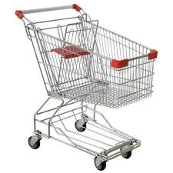




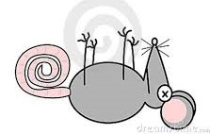
Openness to Ideas
Red Ball Exercise
Everyone form a circle

Slide 24
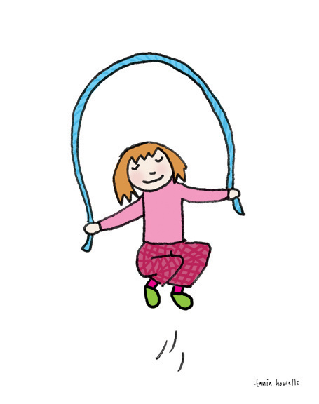
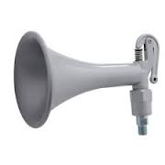


Openness to Ideas
ZOOM
EVERYONE Form a circle
Reverse
Skip
Shift
Dance Party

Slide 25
Classroom Application
Start each class by passing the Zoom (ideas)
Why do company’s allocate cost?
How do you determine target profit?
What does the “death spiral” mean for organizations?

Slide 26
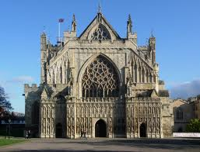
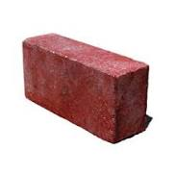
1. Co-Creation
(Circles of 20)
Let’s play Statues
Remember to say thank you – Attitude of Graditude
Bring a
NOT a
Cathedral

Slide 27
1. Co-Create
(Groups of 4)
All of US are smarter than ONE of us!
Let’s play PILLARS
Your idea(s) keep the flow of ideas going

Slide 28

Classroom Application
(Groups of 4)
Build an Operational Story
Class: Provides WHO, WHAT and WHERE
Student 1: Provide a AIS Need or Problem
Student 2: Provide a Financial “Fact” in support of Student 1
Student 3: Provide a Non- Financial “Fact,” that ties the first fact
Student 4: Identify another piece of information they need for the story.

Slide 29
Team vs. Ensemble
TEAM: Implies competition – People forming one side in a game or contest. Freeloaders reduce accountability!
ENSEMBLE: Implies collaboration – Only exists when the members work as one.
Collaborators increase accountability!
Solo Acts are rarely – in fact – solo!

Slide 30
2. Ensemble
(Groups of 8)
Let’s play STRING OF PEARLS
Every idea keeps the flow of ideas going!

Slide 31
Round 1 – Group 1
Students can no longer take the CPA exam while in school
The American Economy collapses

Slide 32
Round 2
All 18 year-olds must complete a Year-of-Service (military, Peace Corps, etc.)
Business fraud virtually eliminated

Slide 33
Round 3
By law, everyone in the U.S. must exercise ONE hour five days a week
The Federal Budget Deficit is eliminated

Slide 34
Round 4 – Classroom Application
All students must learn a statistical analysis software
The Holiday Party was the wildest ever
Can I get a little inductive reasoning up in here!?

Slide 35
String of Pearls & Storylines
Start
Rising action
Middle (Story altering event)
Transformation
Conclusion
Keep what’s necessary but nothing more

Slide 36


5. Keep it Simple
Simple can be harder than complex; you have to work hard to make your thinking clean and simple.
Drawing creates clean thinking, clarity and simplicity.
Thanks Kelly Hepp and Meaghan Decker

Slide 37
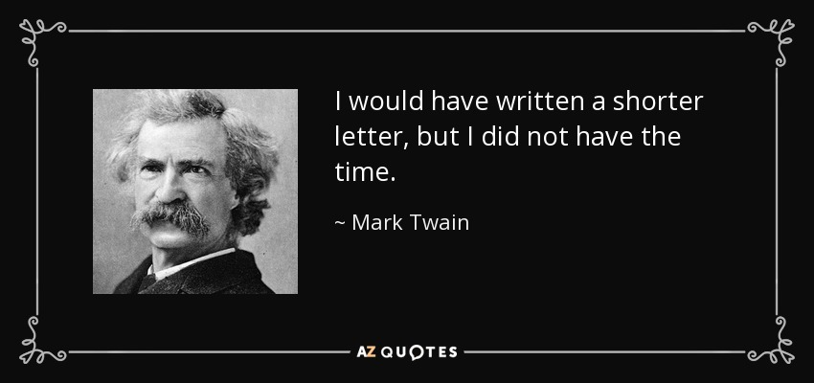

An homage to Professor Cripe

Slide 38
2. Yes-And
(Groups of 3)
Plan THE Next:
AIS Bootcamp Reunion
The More Outrageous the Better
(The ONLY Rule – You have NO Constraints)
YES, And
YES, But
NO
Losada Ratio

Slide 39
Classroom Application
Role play a business meeting!
(Group of 4)
Class: Provides WHO, WHAT AND WHERE
Group: Designate the accountant
Group: Discuss the potential for a new system upgrade
Work through the three approaches: NO, YES-BUT and YES-AND

Slide 40
3. Authenticity
(Be present in the moment)
Let’s play COCKTAIL PARTY
Everyone in the pool!

Slide 41
3. Authenticity
(Be present in the momen)
Let’s play
How does a Smart Phone work?
Groups of TWO!

Slide 42
3. Authenticity
(Groups of 3)
Let’s play TAKE THAT BACK
React positively to UNCERTAINTY
Be Grateful for information (Good & Bad)

Slide 43

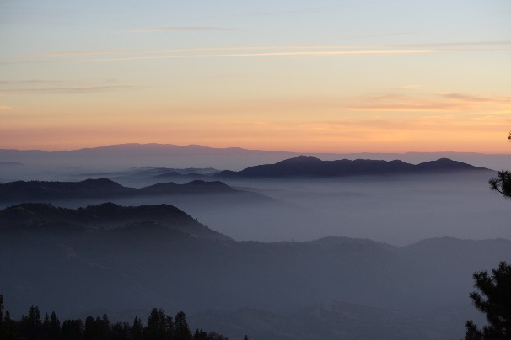
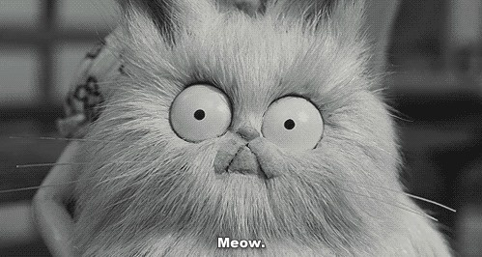
4. Failure
(Groups of 10-12)
Let’s play MISTY VISTAS
Fail Quickly and Move On!
Misty
Vistas
Whiskey
Mixers
Mr. Whiskers

Slide 44
You have my permission to FAIL!

Slide 45
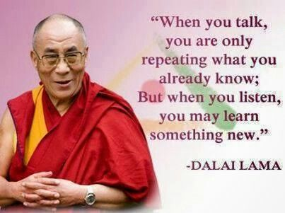
6. Listening

Slide 46
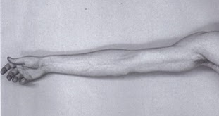
6. Listening: Do we Listen to Respond?
Imagine what others are saying as the length of an arm
When we start tuning out and planning our response!

Slide 47
Or, Listen to Understand
LISTEN TO UNDERSTAND!
(Instead of listening to Respond)
LISTEN FOR INTENT!
(Identify the Emotion)
Half your day is spent listening!
So stay in the moment.

Slide 48
6. Listen
(Groups of 2)
Thank You
How did that change the conversation?
Last Word
How did that change the conversation?

Slide 50
Warning!
It is dangerous to make everyone go forward by the same road, and worse to measure others by yourself!
~ Ignatius Loyola

Slide 51
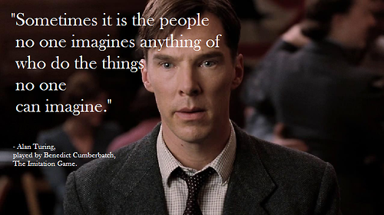

Slide 52


Slide 53
THANKS!
twest522@gmail.com
314-660-3924 (cell)
314-662-5456 (Susan’s cell)

Slide 54
Contact Second City Works
Steve Kakos
312.662.4537
skakos@secondcity.com

Slide 55
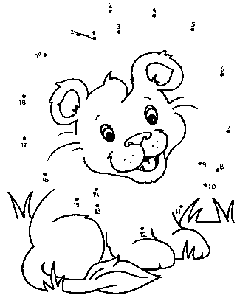

I finally realized – I had ONE talent
184
●
Connect the Dots

Slide 56
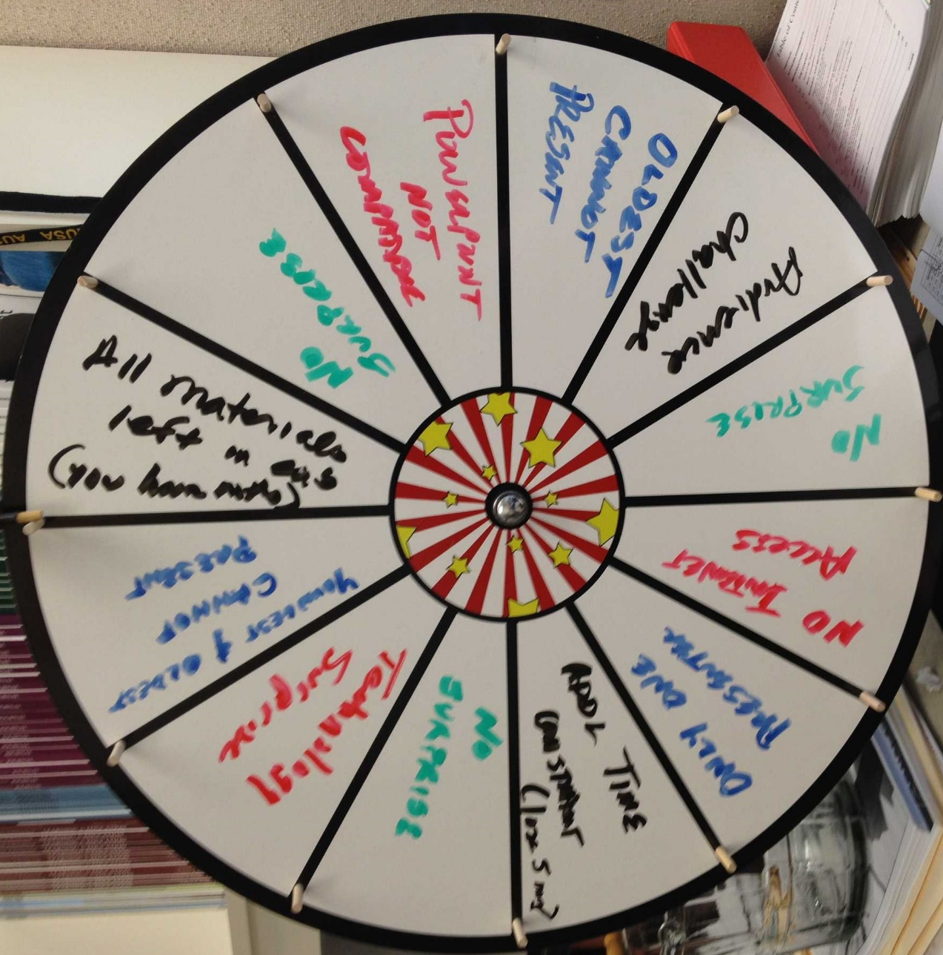
A word about, The Wheel of Doom

